Slide 1
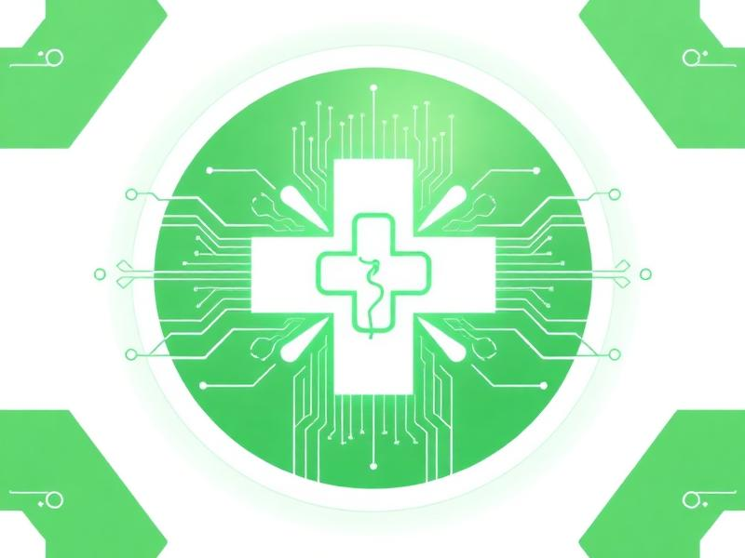
WellBot
AI-Powered Healthcare Chatbot
Your AI Wellness Partner, Always By Your Side
Presented by: Team-D
M. Geethika | Rashi Rathore | R. Jansi Raju
March 2026
1 / 16

Slide 2

Meet Team-D
M. Geethika
Backend Developer & AI Integration
Rashi Rathore
Frontend Developer & UI/UX Designer
R. Jansi Raju
Database & Language switching in chatbot
Technical Stack
Frontend: HTML, CSS, React.js Backend: Python, Flask API AI/ML: Groq AI, RandomForest ML Database: SQLite DB
2 / 16

Slide 3

Project Overview
WellBot is an AI-powered healthcare chatbot that provides personalized wellness guidance across multiple domains including mental health, fitness, nutrition, motivation, and stress relief. Key Highlights: • 6 Specialized AI Chat Specialists for different wellness areas • AI Wellness Predictor powered by RandomForest ML model • BMI Calculator for health metrics tracking • Multi-language support (5+ languages) for global accessibility • Real-time mood prediction and productivity scoring • Interactive dashboard with weekly activity charts and wellness trends • Chat export functionality for record keeping
3 / 16

Slide 4

Vision & Mission
🎯 Our Vision
To revolutionize personal healthcare by making AI-driven wellness guidance accessible, affordable, and available 24/7 to everyone — breaking barriers of language, location, and cost.
🚀 Our Mission
• Provide expert-level wellness guidance through specialized AI chatbots • Enable early wellness prediction using machine learning models • Support multilingual conversations for inclusive healthcare • Empower users to track and improve their daily wellness habits • Deliver a seamless, user-friendly healthcare experience
4 / 16

Slide 5
Proposed Solution
🧠 AI Chat Specialists
📊 ML Wellness Predictor
6 domain-specific chatbots — Mental Health, Fitness Coach, Nutrition, Motivation, Stress Relief, and General Chat — each powered by Groq AI with tailored system prompts.
RandomForest ML model that predicts mood, stress level, and productivity score based on daily inputs like sleep, exercise, caffeine, screen time, and more.
🌐 Multi-Language Support
📈 Smart Dashboard
14+ language support including Hindi, Telugu, Tamil, and more — AI responds in user's preferred language for inclusive healthcare access.
Interactive dashboard with weekly activity charts, mood trends, streak tracking, and feedback ratings — giving users a holistic wellness overview.
5 / 16

Slide 6
Our Development Process
01
Research & Planning
Identified key wellness domains, studied existing healthcare chatbots, and defined project scope and requirements.
02
UI/UX Design
Designed dark-themed, modern UI with intuitive navigation, dashboard layout, and responsive chat interfaces.
03
Frontend Development
Built with HTML, CSS & React.js — creating reusable components, routing, and a seamless user experience.
04
Backend & AI Integration
Developed Flask API endpoints, integrated Groq AI for chat, trained RandomForest ML model for wellness prediction.
05
Testing & Deployment
Comprehensive testing across browsers, multilingual testing, performance optimization, and final deployment.
6 / 16

Slide 7
Application Workflow
1. User visits Landing Page
6. Use AI Wellness Predictor (enter daily stats)
2. Sign Up / Login with credentials
7. Get mood, stress & productivity predictions
3. Access Dashboard with wellness overview
8. Use BMI Calculator for health assessment
4. Choose a Chat Specialist (Mental Health, Fitness, etc.)
9. Track progress via charts & trends
5. Chat with AI in preferred language
10. Export chat history for records
7 / 16

Slide 8
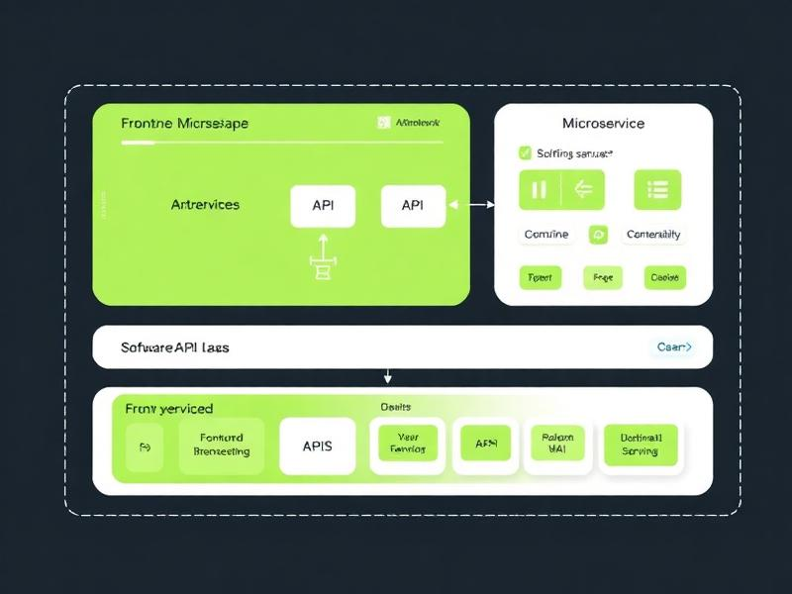
System Architecture
Frontend Layer
HTML, CSS, React.js
Responsive UI, Dark Theme, Multi-language
⬇
API Layer (Flask)
RESTful API Endpoints
Authentication, Chat, Prediction, BMI
⬇
AI/ML Layer
Groq AI (Chat Engine)
RandomForest ML (Wellness Predictor)
⬇
Database Layer
SQLite DB
Users, Chats, Feedback, Wellness Data
8 / 16

Slide 9
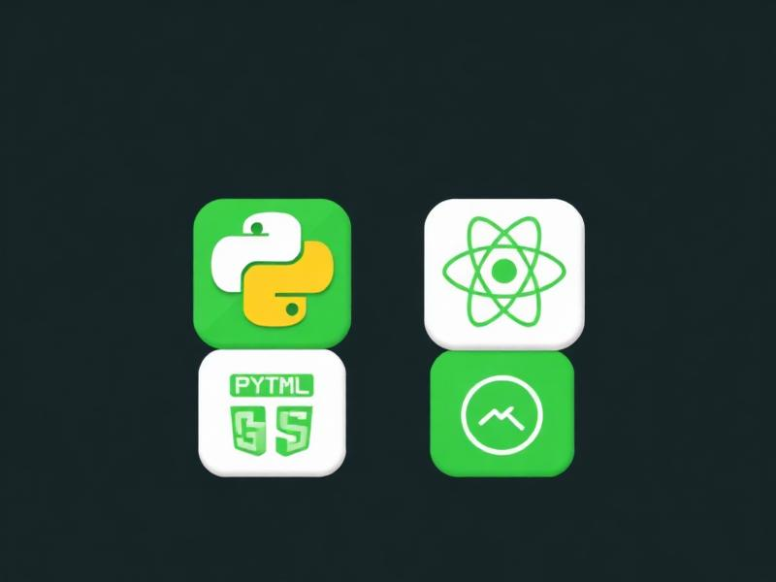
Technical Stack
⚡ Frontend
• HTML5 & CSS3 — Structure and styling
• React.js — Component-based UI framework
• Responsive Design — Mobile & desktop compatible
⚡ Backend
• Python — Core programming language
• Flask — Lightweight web framework & REST API
• Flask-CORS — Cross-origin resource sharing
⚡ AI & ML
• Groq AI — Fast LLM inference for chat responses
• RandomForest ML — Wellness prediction model
⚡ Database
• Scikit-learn — ML model training and evaluation
• SQLite — Lightweight relational database
• User auth, chat history, feedback storage
9 / 16

Slide 10
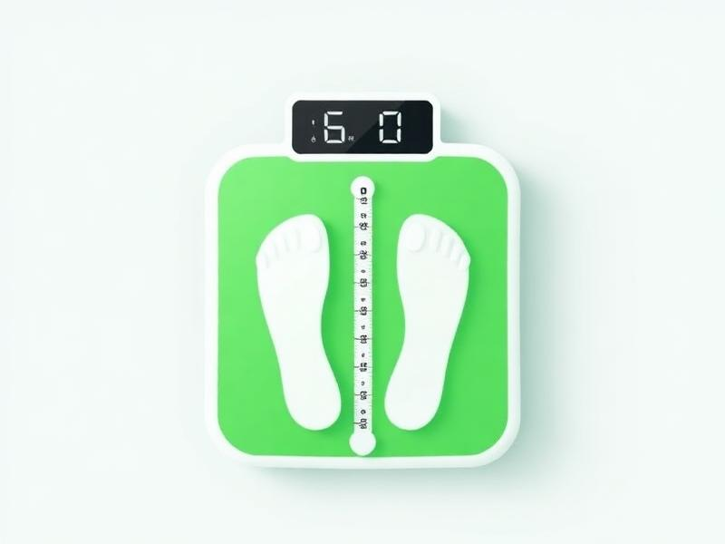
BMI Calculator Feature
WellBot includes a built-in BMI (Body Mass Index) Calculator that helps users quickly assess their body weight category based on height and weight inputs.
How It Works:
1. User enters their height (cm) and weight (kg)
2. BMI is calculated using the standard formula: weight / (height²)
3. Result is categorized: Underweight, Normal, Overweight, or Obese
4. Personalized health tips are provided based on the BMI category
5. Users can track BMI changes over time through the dashboard
💡 BMI is a quick health indicator that complements the AI Wellness Predictor for comprehensive health assessment.
10 / 16

Slide 11
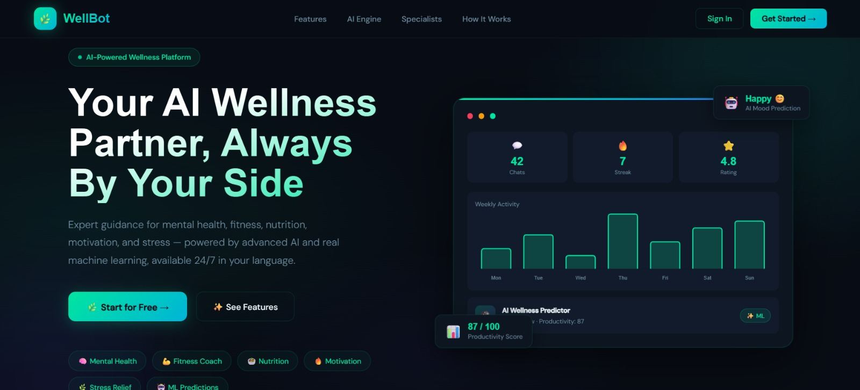
Landing Page
Key Elements: • Modern dark-themed design with green accents • Hero section with clear value proposition • Interactive dashboard preview showing stats • Category badges for wellness domains • Call-to-action buttons: 'Start for Free' & 'See Features' • Navigation with Features, AI Engine, Specialists sections
11 / 16

Slide 12
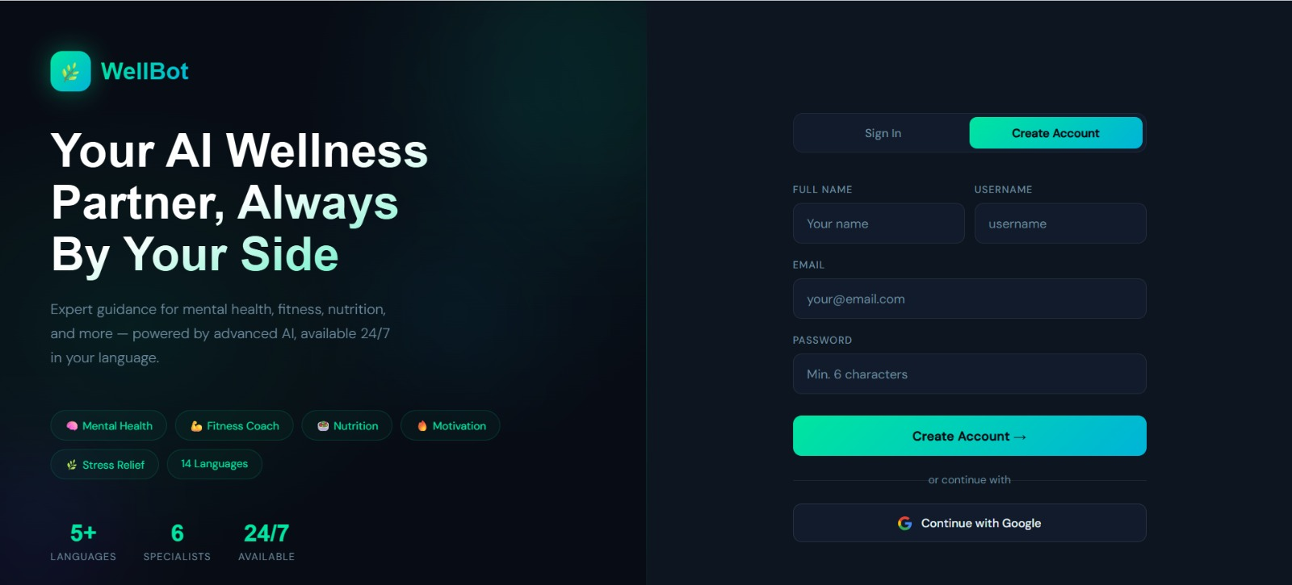
Login & Registration
Key Elements: • Sign In / Create Account toggle tabs • Full Name, Username, Email & Password fields • 'Continue with Google' social login option • Gradient CTA button for account creation • Left panel shows platform features & stats • Stats: 5+ Languages, 6 Specialists, 24/7 Available
12 / 16

Slide 13
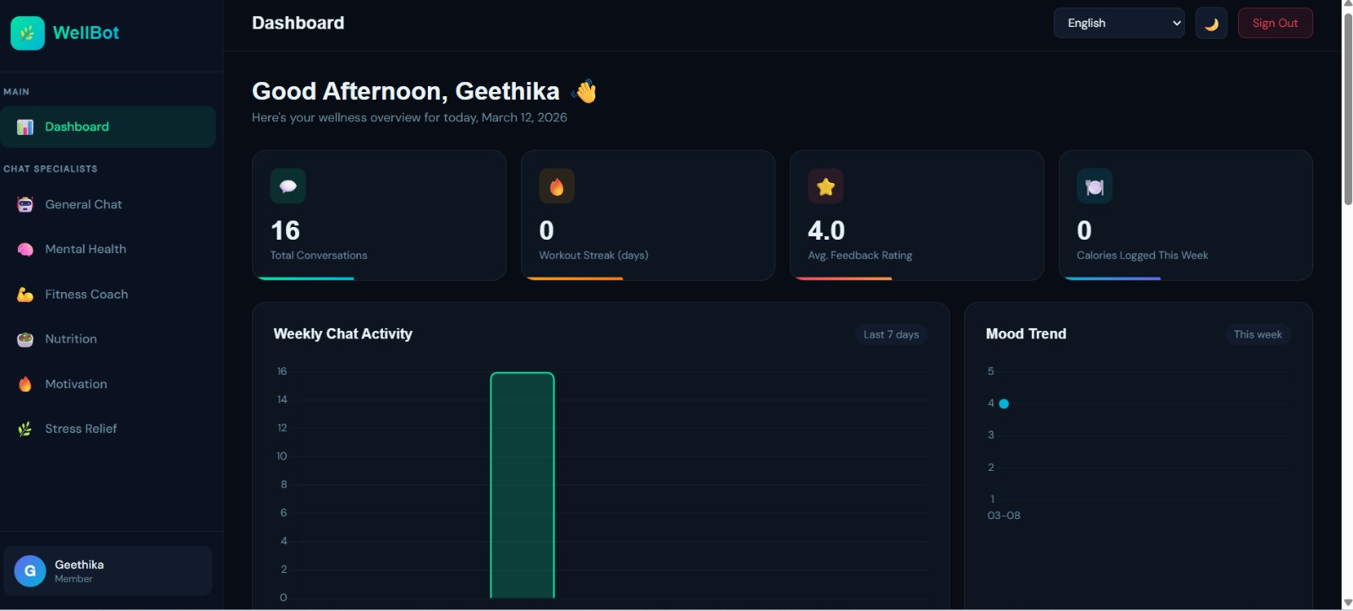
Dashboard & Analytics
Key Elements: • Personalized greeting with time-based message • Stat cards: Conversations, Streak, Rating, Calories • Weekly Chat Activity bar chart • Mood Trend visualization over time • Left sidebar with specialist navigation • Language selector & dark mode toggle
13 / 16

Slide 14
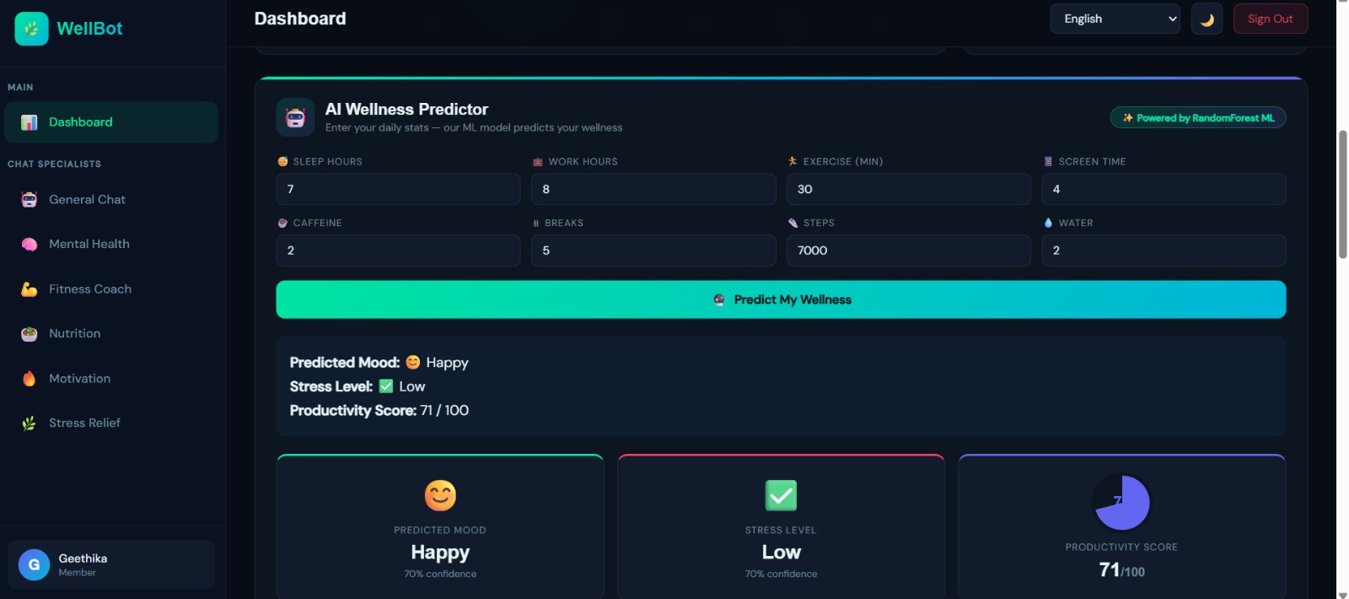
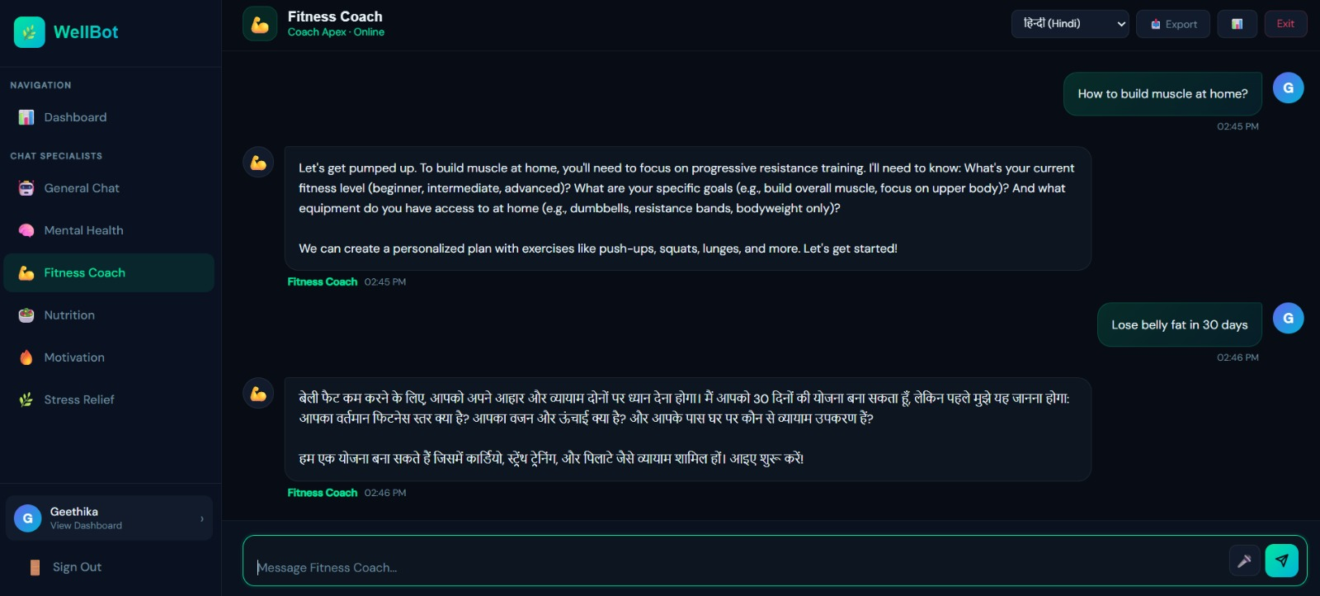
AI Wellness Predictor & Chatbot
AI Wellness Predictor • Enter daily stats: sleep, work, exercise, caffeine, steps, water, screen time, breaks • ML model predicts Mood, Stress Level & Productivity Score • Visual result cards with confidence percentages • Powered by RandomForest ML algorithm
AI Chat Specialists • 6 specialist chatbots for different wellness areas • Real-time AI responses powered by Groq • Multi-language support — responds in user's language • Chat export and history tracking features
14 / 16

Slide 15

Feature Enhancements
🔔 Smart Notifications
📱 Mobile App (PWA)
Push notifications for hydration reminders, exercise breaks, and mood check-ins.
Progressive Web App support for native mobile-like experience on smartphones.
🤝 Community Forum
🏥 Doctor Integration
Peer support groups and wellness communities for shared motivation and experiences.
Connect with real healthcare professionals for advanced medical consultations.
📊 Advanced Analytics
🎮 Gamification
Monthly wellness reports, trend analysis, and personalized improvement suggestions.
Achievement badges, wellness challenges, leaderboards, and reward points system.
⌚ Wearable Integration
🔐 Enhanced Security
Sync with fitness trackers and smartwatches for automatic health data tracking.
Two-factor authentication, encrypted chats, and HIPAA-compliant data handling.
15 / 16

Slide 16
Thank You!
WellBot — Your AI Wellness Partner, Always By Your Side
WellBot demonstrates the power of combining AI, Machine Learning, and modern web technologies to create a comprehensive healthcare assistant. With 6 specialized chatbots, ML-powered wellness predictions, BMI calculator, and multi-language support — WellBot makes personalized healthcare guidance accessible to everyone, anytime, anywhere.
Team-D
M. Geethika • Rashi Rathore • R. Jansi Raju
Questions? We'd love to hear from you! 🙌
16 / 16

